Slide 1
Content Management Systems 1
CS272: Introduction to Web Development
Cole Nelson | Computer Sciences

Slide 2
Learning Objectives
After this lecture, students should be able to…
Understand the basics of the World Wide Web
Define what a Content Management System (CMS) is
Describe how a CMS is hosted on the web.
Compose a basic website with a CMS (WordPress) by…
Uploading media
Publishing pages
Publishing blog posts
Differentiating between blog posts and pages
Using media in pages and posts
CS272 | Introduction to Web Development | CMS 1

Slide 3

What is the World Wide Web?

Slide 4
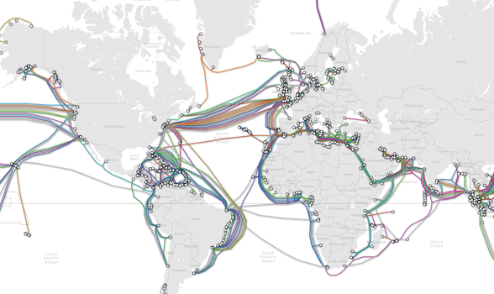
Map of undersea cables from Telegeography

Slide 5



What goes across these cables?*
*primarily, we’ll talk about things like JSON data later…
CS272 | Introduction to Web Development | CMS 1

Slide 6

What about PHP?
PHP is used by the server to generate HTML, CSS, and JS files.
CS272 | Introduction to Web Development | CMS 1

Slide 7




What happens with HTML, CSS, and JS?
A web browser displays them to us!
CS272 | Introduction to Web Development | CMS 1

Slide 8
Where do these files come from, though?
Just another computer! We call it a “server” as it “serves” up content.

Slide 9
What is a Content Management System (CMS)?
A type of server.
A content management system (CMS) is software that helps users create, manage, store, and modify their digital content. (IBM)
A CMS, short for content management system, is a software application that allows users to build and manage a website without having to code it from scratch, or know how to code at all. (HubSpot)
Last time we talked about WordPress!
CS272 | Introduction to Web Development | CMS 1

Slide 10

A Brief History of WordPress
Was originally created in 2003 to create blogs
Has evolved a lot since its inception!
What does this mean for using online resources?
Is available as free and open-source software
Anyone can develop it!
Anyone can use it!
What are the pros and cons of “free and open-source” software?
Has a thriving marketplace of plugins and themes
WordPress itself has default themes and functionality, but additional themes and plugins can be downloaded from the “marketplace”
What impact does this have on security and maintainability?
These may appear as discussion questions! ☺
CS272 | Introduction to Web Development | CMS 1

Slide 11
WordPress Essentials
The theme dictates how pages and posts are displayed.
For now, let’s stick with the default theme!
Please do not change this.
Both pages and posts hold content; this could be…
Headings
Text
Images
… and much more!
Pages are intended for static content that doesn't change frequently.
Posts are intended for blog entries or articles that are time-sensitive.
Posts can also be tagged and categorized – more on that next time!
CS272 | Introduction to Web Development | CMS 1

Slide 12
Let’s Play Page Vs. Post
I give you a title, you tell me if it’s a page or post!

Slide 13
Page or Post?
About Us
CS272 | Introduction to Web Development | CMS 1

Slide 14
Page or Post?
Badger Bytes: August Edition
CS272 | Introduction to Web Development | CMS 1

Slide 15
Page or Post?
Contact Us
CS272 | Introduction to Web Development | CMS 1

Slide 16
Page or Post?
Privacy Policy
CS272 | Introduction to Web Development | CMS 1

Slide 17
Page or Post?
My Trip to Jamaica!
CS272 | Introduction to Web Development | CMS 1

Slide 18
Page or Post?
FAQ
CS272 | Introduction to Web Development | CMS 1

Slide 19
Page or Post?
College Dorm Room Cleaning: Tips & Tricks
CS272 | Introduction to Web Development | CMS 1

Slide 20
Let’s dive into WordPress!
Creating your first Page “About Me” and Post “Back on campus again!”

Slide 21
Adding Media
Introducing the Media Library

Slide 22
Using WordPress Media
Any media type is important, but certain types may have additional attributes.
Every image should have appropriate alt text.
Captions and descriptions are also helpful, but not totally necessary!
Captions can be included in the Block Editor
Be careful when you upload something! It becomes immediately available to everyone, so long as they have a URL.
Pretend that anything you upload is public!

Slide 23

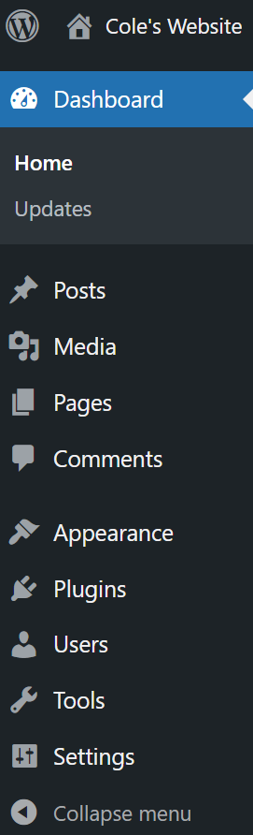
Image from Over the Hedge (2006)
Don’t go over the hedge! We’ll get there soon enough! ☺

